Slide 1


Voice techniques and Body language
TRƯỜNG ĐẠI HỌC BÁCH KHOA HÀ NỘI
HANOI UNIVERSITY OF SCIENCE AND TECHNOLOGY
SOICT - 2020

Slide 2
Content
Voice technique
Body language

Slide 3
Content
Voice technique
Body language

Slide 4
Voice technique
DO you realize that what you say is actually not as important than how you say it?
And scientists have long proved that:
only 17 per cent of our impression
from a communication comes from words said.
No matter how interesting your speech looks on the paper; if you deliver it in a boring monotone standing dead there in front of everybody, value of your presentation comes to nothing.

Slide 5
What is Voice technique
VOICE is a musical instrument. It has endless emotional capacity, and is able to make deepest impressions upon its listeners. And we don’t need to pay for this instrument — it’s always there with you.
And it’s your main instrument while giving a presentation. Not slides and not curious facts. Even a great story will fall flat if delivered poorly. On the other side, vocal delivery is able to create suspense, enthusiasm, and excitement, to complement the drama of the plot, to make your story much more vivid and easier for listeners to follow.

Slide 6
Vocal delivery: general advice
Tempo and Chunking
Never rush. Vary the speed — don’t talk at the same pace all the time.
And pause from time to time — a few seconds of silence are sometimes just as effective as words. Pausing in the wrong place sounds like a hesitation. But nothing is more dramatic than a well-placed pause.

Slide 7
Vocal delivery: general advice
Pitch and Intonation
Vary the pitch (high pitch = soprano, low pitch = bass). It will let you not only give information but interpret it, show your listeners exactly what it means for you all.
A good way of varying the pitch is to introduce question into your presentation. This should force you to raise the pitch a little. But be very careful with high pitch people subconsciously like high pitch much less than low voice. And don’t vary your pitch too often and too dramatically, otherwise you will sound like a weird opera singer.

Slide 8
Vocal delivery: general advice
Volume
Adjust your voice to the size of your audience, to the room you’re presenting in. There is no need to shout, yet everybody must hear you clearly. Vary the volume. A quieter part can contrast with a louder part and create dramatically different effects.

Slide 9
Vocal delivery: general advice
Articulation
The sounds will be clearer if you don’t rush your words. If you anticipate difficulty in pronouncing certain key words, practice them beforehand. Usually the problem is the syllable stress.

Slide 10
Vocal delivery: general advice
Sentence length and style
It’s hard to aurally comprehend complex sentences and difficult words. Avoid reading your text — this should keep the sentences fairly short. Plus, it will sound natural, and you should always sound natural.

Slide 11
Vocal delivery: general advice
Language mistakes and accent
Before presenting, check thoroughly all the problematic words: are you reading them correctly? If you make one mistake in the presentation, this will not disturb anyone, but if you pronounce the same word in a wrong way over and over again, that would be very bad.
Still, our mother tongue being not English, we are naturally allowed to have foreign accent. Practicing and trying to sound as close to native speaker as possible is good, but do not overemphasize the impact of a minor foreign accent.

Slide 12
Important Voice techniques
Stress
Pacing
Emphasizing

Slide 13
Stress
By stressing particular words (or parts of words) in a sentence you can subtly change the its meaning. Try reading out each of the following examples with different stress.
We all know that this is an extremely difficult market. (it’s more than just difficult)
We all know that this is an extremely difficult market. (you and I agree on this)
We all know that this is an extremely difficult market. (but they don’t)
We all know that this is an extremely difficult market. (but we do little about it)

Slide 14
Pacing
You can use pauses to slow your pace down and make your sentences easier to understand and more effective sounding. Group words into phrases according to their meaning and make pauses between the phrases.
In my opinion we should go into other markets.
In my opinion // we should go // into other markets.
On the other hand, the figures prove that we are on the right track.
On the other hand, // the figures prove // that we are on the right track.
In general, you should slow down to make your most important pints.
This gives your message time to sink in.

Slide 15
Emphasizing
IT is always a good idea to exaggerate a little — it helps to get your message across persuasively and to dramatically change the significance of what you say. There are various ways to emphasize some ideas in a speech.

Slide 16
Emphasizing
First, you can stress words which are normally unstressed or contracted. These are mainly auxiliary verbs (be, have, can, etc.) and negatives.
For example, read out the following sentences, stressing the underlined words:
Neutral Remark
It’s our best chance of success.
We were hoping for a better deal.
We are doing the best we can.
We have tried to limit the damage.
We can’t go ahead with this.
I see what you mean.
They promised completion by June.
It isn’t cost-effective.
Do we or don’t we believe in service?
Emphatic Remark
It is our best chance of success.
We were hoping for a better deal.
We are doing the best we can.
We have tried to limit the damage.
We cannot go ahead with this.
I do see what you mean.
They did promise completion by June.
It’s not cost-effective.
Do we or do we not believe in service?

Slide 17
Emphasizing
Second, you can place emphasis on particular words and phrases. Look at the following and notice how the effect is changed by a change of emphasis:
This was successful.
This was very sucCESSful.
This was VEry successful.

Slide 18
Emphasizing
Third, you can use so-called intensifiers to emphasize your points.
I’m afraid it just isn’t good enough — the entire system needs updating.
We really need to rethink our whole recruitment procedure.
Paying off such a substantial loan is going to be extremely difficult.
We have done much better than we expected — even better than we did last year.
That’s absolutely no chance at all of us going into profit in the first two years.

Slide 19
Emphasizing
Adverbs are especially often used as intensifiers. Intensifier adverbs can be total, very strong, or moderate.
Total
absolutely (fantastic) completely (awful) entirely (depressing)
Very strong extremely (good) very (bad)
Moderate fairly (safe)
reasonably (expensive) quite (cheap)
In more formal speech some verbs and intensifier adverbs form fixed expressions. Your English will greatly benefit from learning such expressions. A typical pattern is:
Subject Intensifier Main Verb Complement
I completely agree with everything you’ve said so far.
We firmly oppose any suggestion that the company
be sold.

Slide 20
Emphasizing
Fourth, another way of emphasizing your thought is the 'what... is ...’ pattern. Using it, you can focus key points so that everyone knows you want them to listen to what you have to say next.
Compare:
We can’t expect too much.
What we can’t do is expect too much too soon.
I’d like to approach this question from two different angles.
What I’d like to do is approach this question from two different angles.

Slide 21
Emphasizing
And finally, you can actually use the verbs to stress, emphasize, etc.
I’d like to stress the following point.
I’d like to draw your attention to the latest figures.
I’d like to emphasize that our market position is excellent.

Slide 22
Key points of voice technique
General advice:
Articulate.
Keep your sentences short.
Check the spelling of difficult words.
To create rich delivery:
Vary the speed, volume intonation.
Use various Stress, Pacing and Emphasis techniques.
Sound natural. Be eloquent and vivid

Slide 23
Content
Voice technique
Body language

Slide 24
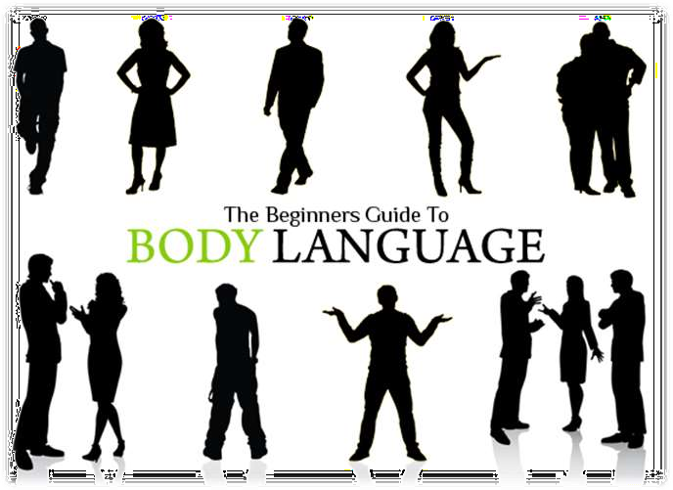
What is body language?

Slide 25

Body Language is:
What is body language?
Body language is the non-verbal communication that involves body movement.
Gesturing can also be termed as body language which is an absolutely non-verbal mean of communication.
People in the workplace can convey a great deal of information without even speaking; through nonverbal communication.

Slide 26
Body Language is:
How does body language talk?
Like any spoken language, body language has words, sentences and punctuation.
Each gesture is like a single word and one word may have several different meanings.

Slide 27
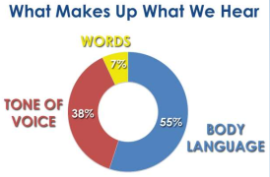
Importance of body language?
Body language plays a big role in intuition as it gives us messages about the other person, that we can interpret at an intuitive level.
10

Slide 28
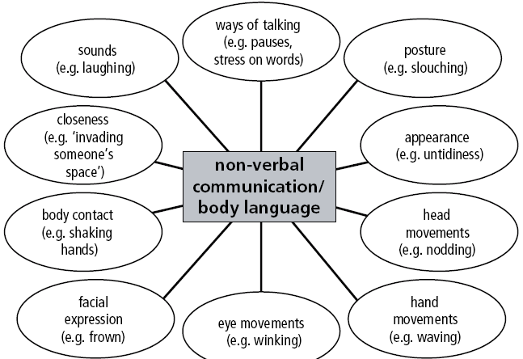
Nonverbal communication/body language
11

Slide 29
Basic body languages
Eyes
Blocking
Hands
Animations
Smile

Slide 30

Eyes
Common mistake: Taking your eyes off of listeners.
Do you read directly from a PowerPoint presentation instead of addressing the audience?
In a one-on-one conversation, do you glance to the side, down at your feet, or at the desk?
Ever catch yourself looking over the shoulder of the person you’re talking to?

Slide 31

Eyes
The winning technique: Keeping your eyes on your audience.
If you’re giving a presentation, commit your material to memory so you can connect instead of read. In small groups or meetings, maintain eye contact equally with everyone in the room. During one-on-one conversations, keep your eyes on the person you are speaking to 80% to 90% of the time.

Slide 32
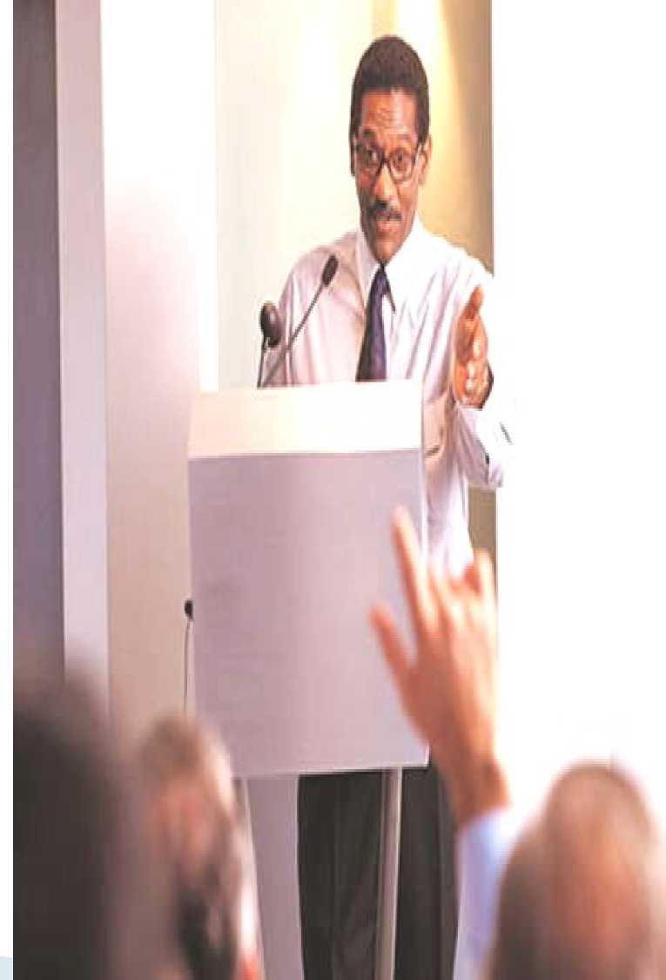
Blocking
Common mistake: Putting something between you and your listener (s).
Crossing your arms, standing behind a podium, standing behind a chair, and talking to someone from behind a computer monitor are all examples of blocking.

Slide 33
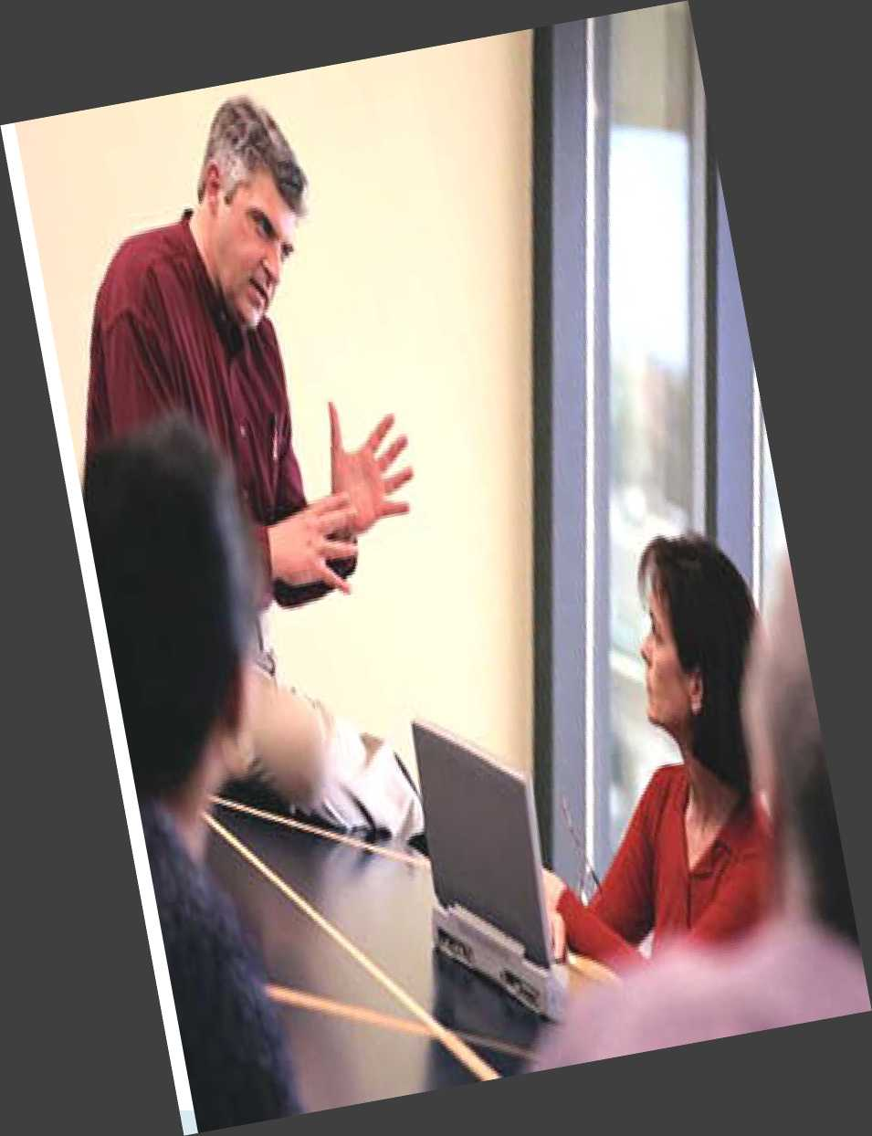
Blocking
The winning technique: Staying "open"
Keep your hands apart and your palms up, pointed toward the ceiling. Remove physical barriers between you and your listeners.

Slide 34
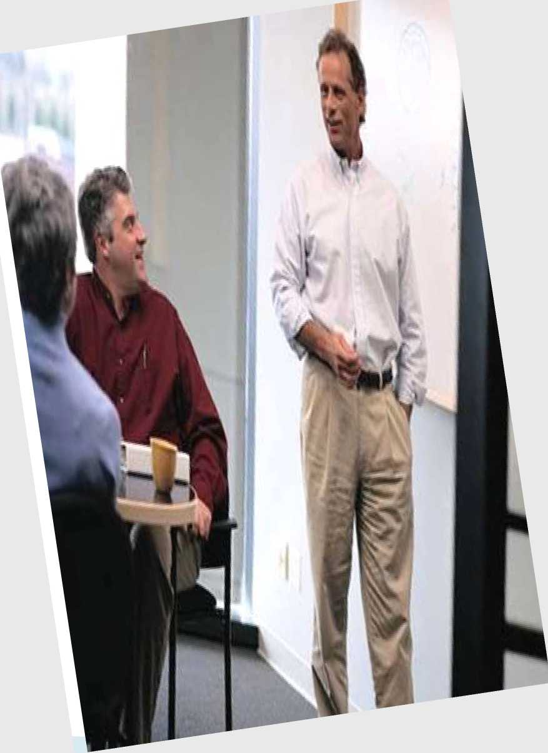
Hands
Common mistake: Not using them.
Keeping your hands in your pockets or clasped together makes you seem stiff, stilted, and formal. It conveys insecurity, whether or not you’re insecure.

Slide 35

Hands
The winning technique: Using complex hand gestures.
Engaging both hands above the waist is an example of a complex hand gesture that reflects complex thinking and gives the listener confidence in the speaker. Just watch such charismatic speakers as Bill Clinton, Colin Powell, Barack Obama, or Tony Blair.

Slide 36
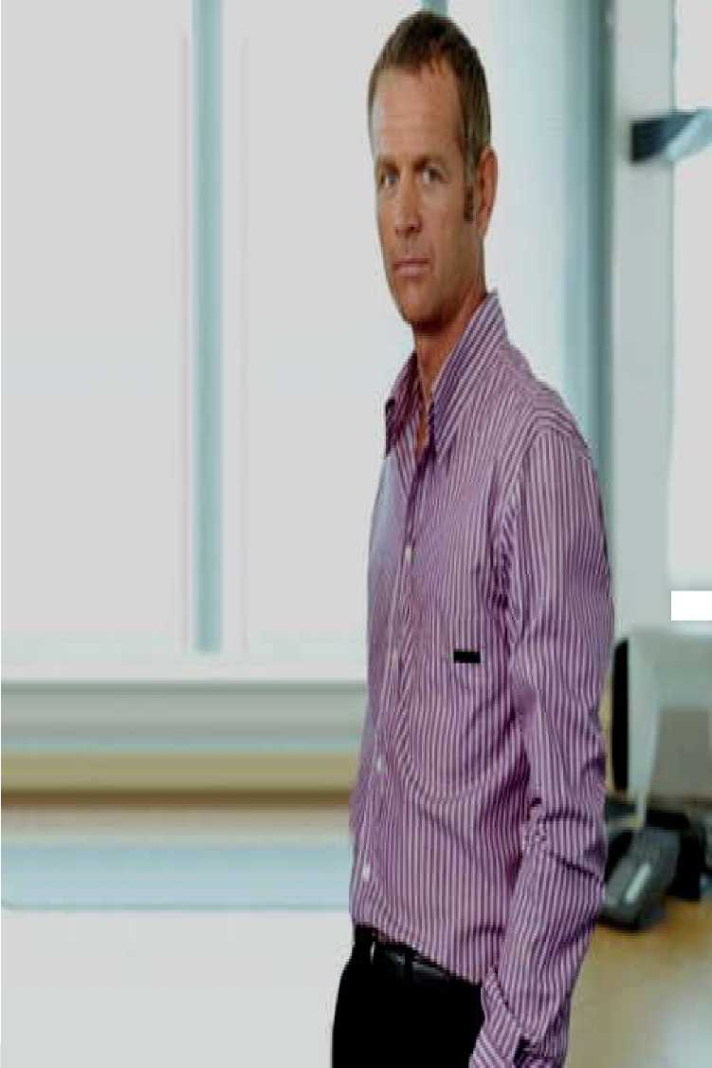
Animation
Common mistake: Standing or sitting perfectly still.
Ineffective speakers barely move, staying in one spot during a presentation.

Slide 37

Animation
The winning technique: Animate your body, not your slides.
Great speakers get up and move, and when appropriate, mingle with the audience, like Cisco Chief Executive John Chambers, who often walks into the audience as he speaks.

Slide 38

Smile
Mahatma Gandhi has also mentioned that,
"You are not completely dressed until your face wears a SMILE

